Slide 1
ADM Nimbus and Blueshift Demo Environments
Mark Steffensen
mark.steffensen@microfocus.com
Technical Enablement
Partner Boot Camp 2020 – São Paulo

Slide 2
Technical Enablement
Welcome!
Please ask questions
We’re here to help!

Slide 3
São Paulo Technical Enablement Partner Bootcamp
March 9-12 |  | Monday |  | Tuesday |  | Wednesday |  | Thursday |  | Friday
9:00 | 10:15 | Mark Steffensen | Nimbus & Blueshift Overview | Mark Steffensen | Devops Unravelled Managing Quality | Mark Steffensen | Creating Testing Jobs in Jenkins | Mark Steffensen | Integrating with SonarQube
10:15 | 10:30 | Break
10:30 | 12:00 | Mark Steffensen | Nimbus & Blueshift Overview | Mark Steffensen | Analyzing Data Administration and Settings | Mark Steffensen | Integrating UFT One AI Testing Preview | Mark Steffensen | Building the Account Service
12:00 | 13:00 | Lunch
13:00 | 15:00 | Mark Steffensen | Kahoot! Quiz Nimbus-Blueshift Octane Overview Intro to Octane Configuring Octane | Mark Steffensen | Kahoot! Quiz ALM Octane Jenkins and DevOps Tracking Code Changes | Mark Steffensen | Kahoot! Quiz ALM DevOps Security Testing | Mark Steffensen | Kahoot! Quiz DevOps Testing Additional Topics
15:00 | 15:30 | Break
15:30 | 17:00 | Mark Steffensen | Octane UI Agile Backlog Defining Test Coverage | Mark Steffensen | Working with Gherkin | Mark Steffensen | Synchronizing with MF Connect | Mark Steffensen | Additional Topics

Slide 4
What will you learn?
Nimbus demo architecture
Blueshift demo environment
Linux desktop
Linux commands
Docker commands
Nimbusapp commands
Some devops basics

Slide 5
Our Enablement Strategy
Slides and Lecture 10%
Demonstrations 5%
Self-Directed Exercises 80%
Challenge Activities 5%

Slide 6
Course Roadmap
ADM Demo Environments
Nimbus Demo Environment
What is Nimbus/Blueshift?
Nimbus and Docker
Nimbus VM’s
Docker and Linux Commands
Nimbus Best Practices
Hands-on Exercises
Notes:
This presentation provides an overview of the Nimbus Demo Environment.
[PRESS] What is Nimbus?
[PRESS] How are Nimbus and Docker related?
[PRESS] What are some common Docker commands?
[PRESS] What are some basic Linux commands?
[PRESS] How do I use Nimbus on AWS?
[PRESS] What are some Nimbus best practices?
[PRESS} Followed by some hands-on exercises.

Slide 7

What is Nimbus?
Nimbus is an easy to use, container-based demo environment
Nimbus utilizes 3 virtual machines:
NimbusServer – Contains Docker and is used to pull Linux-based ADM images
NimbusClient – Contains the ADM client solutions that only run on Windows
NimbusWindows – Contains Serena/Borland products that are server-based
All ADM products are licensed via Autopass or local tied-to-seat licenses
Images are provided with embedded integrations to other solutions
Images are stored on Docker Hub under the admpresales repository
Images are typically self-contained applications with web server, app server, database, etc.
All software is to be used for demonstration purposes only
Production use is not allowed nor recommended

Slide 8

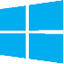
Nimbus Simplified
NimbusServer
NimbusClient
NimbusWindows
Octane
ALM / QC
Jira
Chrome
UFT One
LoadRunner Pro
Silk Test
Chrome
Dimensions RM
Silk Central
Release Control
Chrome
App Containers
Client Apps
Server Apps

Slide 9



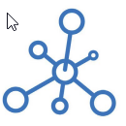

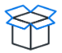



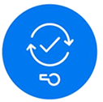










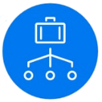





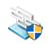






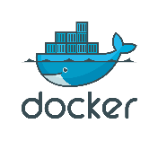


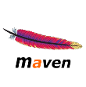



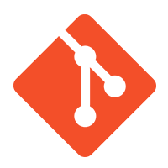
Nimbus Platform – Architecture
Nimbus Server
Dimensions
CM
ALM Octane
Fortify SSC
PPM
Roundcube Webmail
TE Simulator
Nimbus Client
Nimbus Windows
UFT One
UFT Dev
Sprinter
Silk Central
UFT For RPA
RPA Clients
MF Connect
ALM / QC
Fortify SCA
AutoPass
Dimensions
RM
Dimensions CM
TE Simulator
LoadRunner
SV Designer
UFT Mobile Add-in
Release Control
SBM
JIRA
UFT Mobile
Network Virtualization
SV Server
RPA Servers
Mattermost Chat Server
Silk Performer
Silk Test
& WebDriver
WebInspect
Deployment Automation
AOS
UFT Dev
IntelliJ
SonarQube
Sitescope
Reflection
Network Virtualization
DevOps

Slide 10
What is Blueshift?

Slide 11
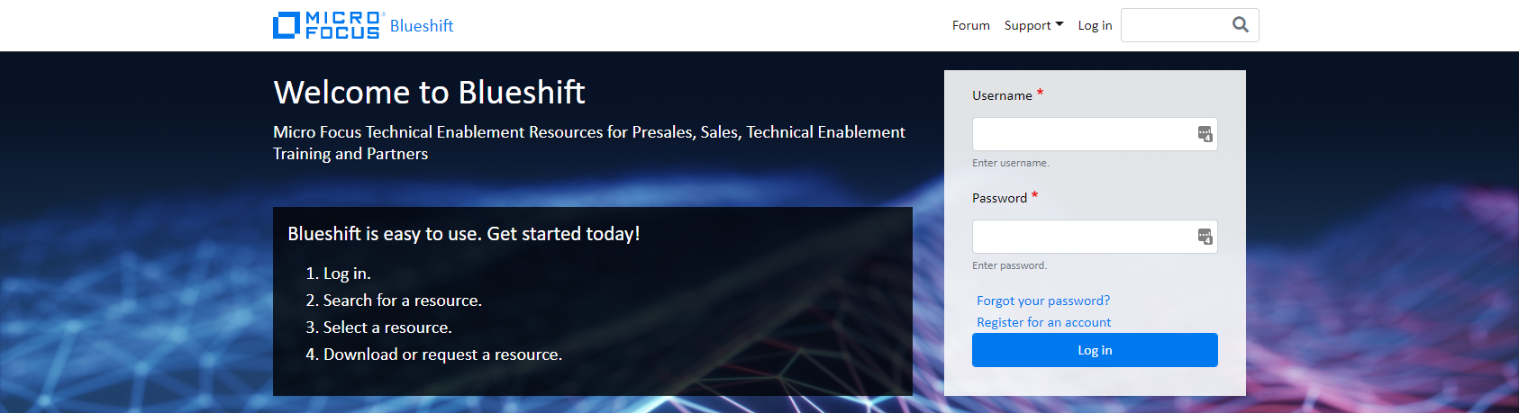
What is Blueshift?
Updated Stratus demo environment
Cloud-based demo consolidation site using AWS
Demo and materials portal available to Micro Focus and their partners
Modern, focused and responsive demo asset delivery platform
Live subscription requests are typically provisioned in under 15 minutes
No charge for partners under normal circumstances
Utilizes Guacamole – a browser-based RDP client running on port 80
Longer term reservations are available – contact Blueshift support
Images are suspended after 4 hours of idle time
Literal definition - Any decrease in wavelength and increase in frequency caused by relative motion (i.e. the object in motion is getting closer to you)

Slide 12
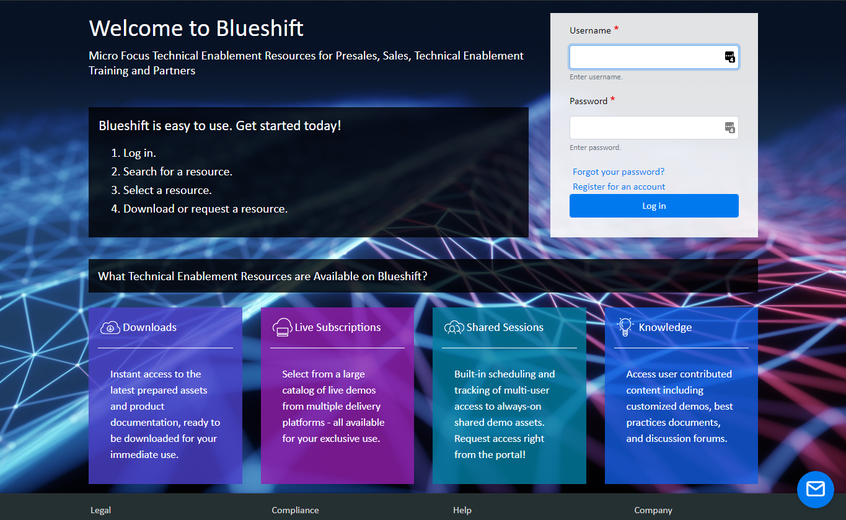
Blueshift Architecture
adm_training
Brazil2020
NimbusServer
NimbusClient
NimbusWindows

Slide 13
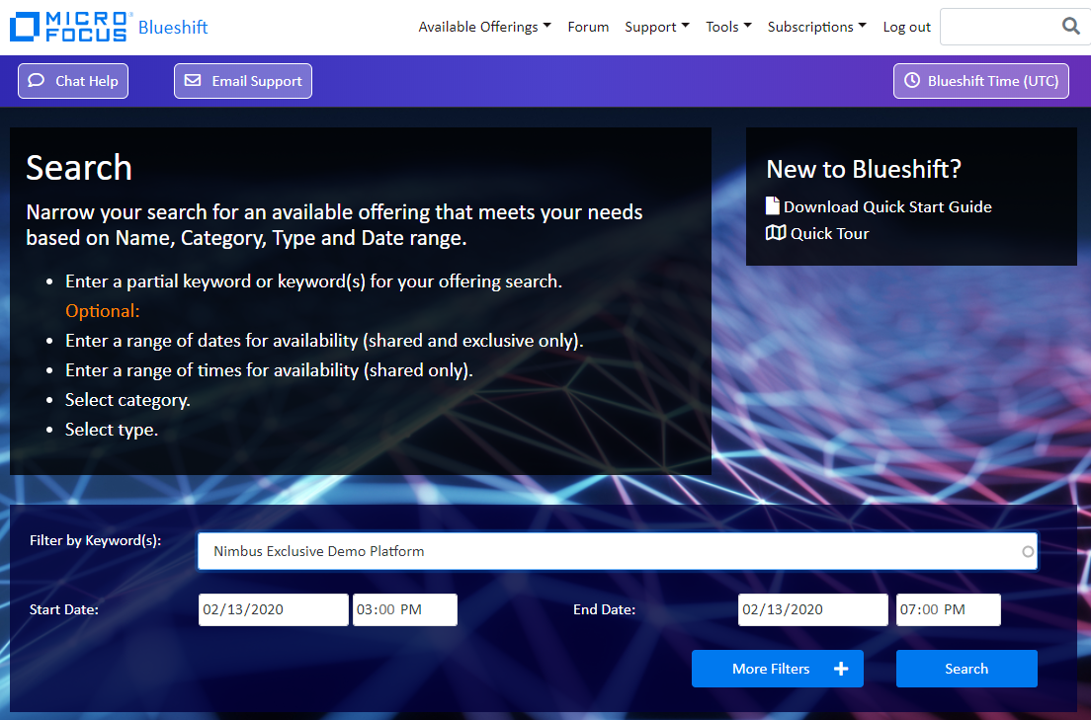
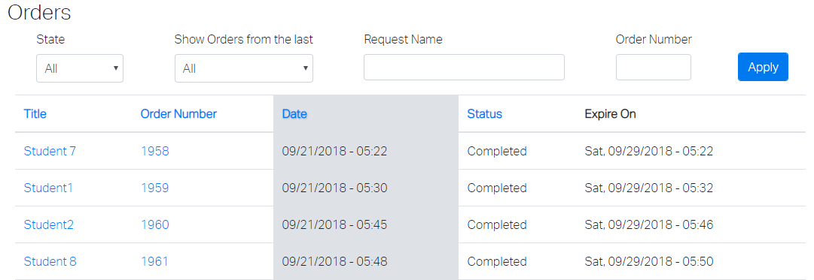
Using Blueshift
Log in credentials (https://mfdemoportal.com)
Username = adm_training
PW = Brazil2020
Select Subscriptions > My Orders at the top
Select your assigned name from spreadsheet – e.g. Brazil Student 12
Verify status is Running (if stopped, select Start and Execute and wait a few minutes)
Select (for NimbusClient, NimbusServer and NimbusWindows)
A new browser tab opens up and the desktop is inside the browser

Slide 14

What is Advantage Online Shopping?
Public and private demo website
Public IP: http://advantageonlineshopping.com
Private IP: http://nimbusserver.aos.com:8000
Modern design mock e-commerce site for demos
Administration of AOS through:
Built-in admin site at: http://nimbusserver.aos.com:8000/admin/
Login with admin, adm1n
WPF Client is also available
Source code is available on devops docker container in git
Examples exist for modifying root and accountservice

Slide 15
Blueshift Demo
Log in credentials:
Website = https://www.mfdemoportal.com
Username = adm_training
PW = Brazil2020

Slide 16
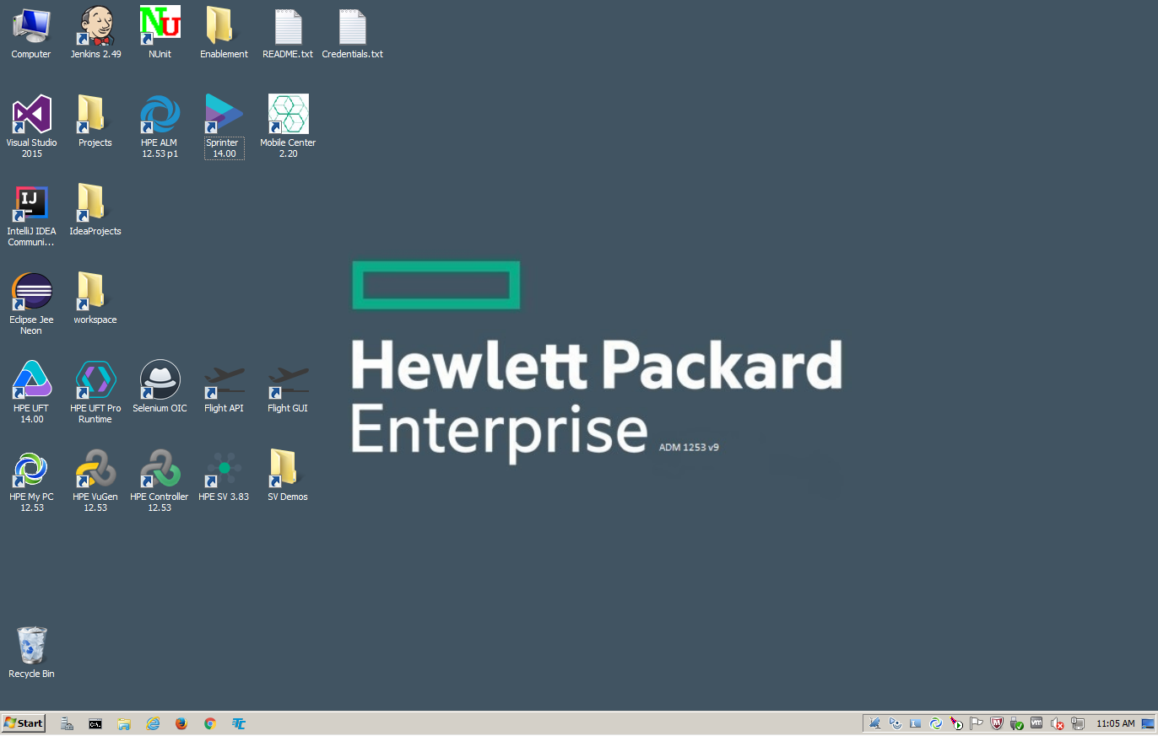
Why did we change from an All-in-One image?
Nimbus has:
More flexibility
Fewer field updates needed
Smaller images/downloads
Latest versions always available
Only get what you need
Networking is not required
Integrated images for demos
Demo older releases too
All-in-One image is no longer available

Slide 17
Course Roadmap
ADM Demo Environments
Nimbus Demo Environment
What is Nimbus/Blueshift?
Nimbus and Docker
Nimbus VM’s
Docker and Linux Commands
Nimbus Best Practices
Hands-on Exercises
Notes:
This presentation provides an overview of the Nimbus Demo Environment.
[PRESS] What is Nimbus?
[PRESS] How are Nimbus and Docker related?
[PRESS] What are some common Docker commands?
[PRESS] What are some basic Linux commands?
[PRESS] How do I use Nimbus on AWS?
[PRESS] What are some Nimbus best practices?
[PRESS} Followed by some hands-on exercises.

Slide 18
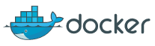
How does Docker play into Nimbus
The rise of Docker Explained
Docker basically made containers extra-simple for people. Docker is essentially a wrapper around the Linux container technology that makes it easier to use.
Cloud computing with virtual machines (EC2, Rackspace Cloud) revolutionized the market from an “I need a server, now” perspective. But many people still treated VMs like normal servers.
But a docker container is basically a stripped-down version of an OS that lives within the existing OS instance instead of on top of it. You can now build and ship containers to any server running Linux.
This hugely increases the portability of applications - you can actually deploy the same image to Rackspace or Amazon, or any other cloud provider, without any issue.

Slide 19
What are the Docker principles?
Basic Docker Tenets
All containers share the kernel with the host
The Dockerfile is a blueprint for the image
Each service or function should have its own container*
Containers can talk to each other and to the world
docker network create --subnet 172.50.0.0/16 demo-net
Images are stored in a central repository
Each container has its own file system
* We often break this rule with our demo containers

Slide 20
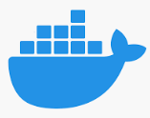
What are Docker images and containers?
Image
Data
A Docker image is typically stored on Docker hub and downloaded locally
A Docker image is an application base state as pulled from the repository
A Container is a dynamic instance of a Docker image
Images are “run” or “started”
Your changes persist when stopping/starting the container
Removing a container still leaves the docker image on the file system
Containers can be “committed” back to an image
Container
Changed Data

Slide 21
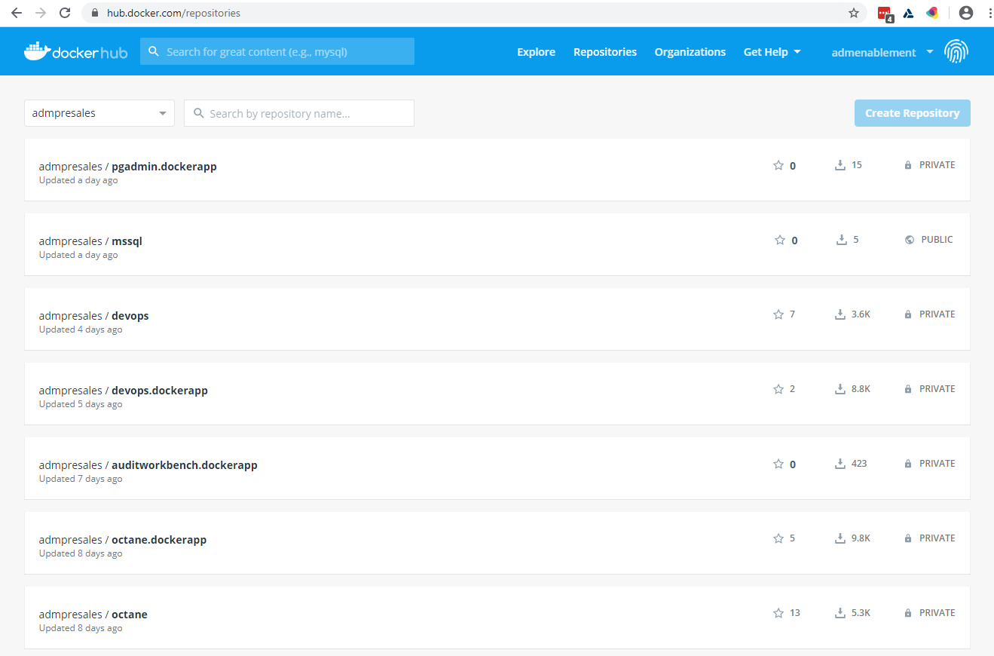
What is on Docker Hub?
https://hub.docker.com/repositories
Notes:
You can access our public Docker Hub at https://hub.docker.com.
Make sure that after you log in that you select admpresales as your repository.
You will also have your own personal repository that you could use to save or pull images from.

Slide 22
How does Nimbus use Docker?
The Nimbus Demo Environment
Docker images are self contained applications
A public Docker Hub houses all the images
No third-party licenses (e.g. applications use Oracle XE, SQL Express)
Integrations are built-in and configured
Advantage Online Shopping source code is contained in the DevOps image
Build tools (e.g. Maven, Bower, Grunt) are also on the DevOps image
IntelliJ Community Edition is also a Docker container
Three VM Strategy
 | NimbusServer |  | NimbusClient |  | NimbusWindows
Memory | 16+ GB free | 20 GB preferred | 6+ GB free | 8 GB preferred | 13+ GB free | 16 GB preferred
CPU | Intel i5 | i7 preferred | Intel i5 | i7 preferred | Intel i5 | i7 preferred
Disk Space | 50-120 GB | SSD preferred | 35 GB | SSD preferred | 40 GB | SSD preferred

Slide 23
Docker and nimbusapp commands demo

Slide 24
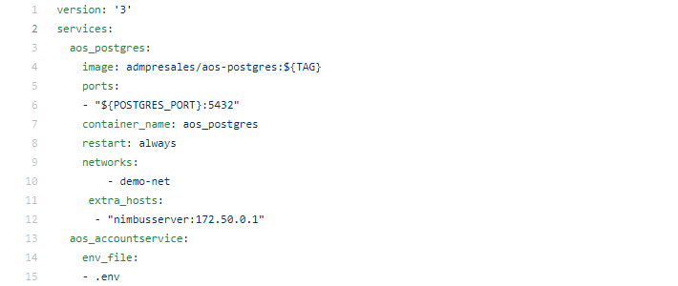
The next phase for Nimbus – nimbusapp
What is docker-compose?
A YAML file that runs a bunch of containers at once, defining services, dependencies, networks, etc.
What does docker-app add?
Embeds and substitutes a defined set of variables (located at the bottom of YAML).
Setting Default
------- -------
ACCOUNT_AGENT_NAME aos-accountservice-dev
ACCOUNT_IP nimbusserver
POSTGRES_PORT 5432
Shortened startup commands
$ docker-app render admpresales/aos.dockerapp:2.2 | docker-compose -p aos-dev -f - up –d
becomes
$ nimbusapp aos:2.2 up

Slide 25
Nimbusapp examples
nimbusapp keeps track of versions
~/.nimbusapp/apps-config
nimbusapp commands: up, down, start, stop
up – download and start container(s) or start local container(s)
down – stop and remove running containers (leave images)
start – start local container(s)
stop – stop local container(s)
$ nimbusapp aos:2.2 up
$ nimbusapp octane:15.0.20.58 up
$ nimbusapp octane stop
-> Spins up 3 containers
-> Spins up 1 container
-> No version number needed

Slide 26
Partner access to VM’s and Docker Images

Slide 27
How do Partners get access to the docker images?
Log into https://hub.docker.com and create a Docker ID
Use your corporate email address only (no @gmail.com or @yahoo.com)
Send us your Docker ID
Email your Docker ID along with your company and phone number to:
mark.steffensen@microfocus.com and keith.cutler@microfocus.com
We will grant you access to http://hub.docker.com/admpresales
If you have any other questions about Nimbus please send an email to
mark.steffensen@microfocus.com or keith.cutler@microfocus.com

Slide 28
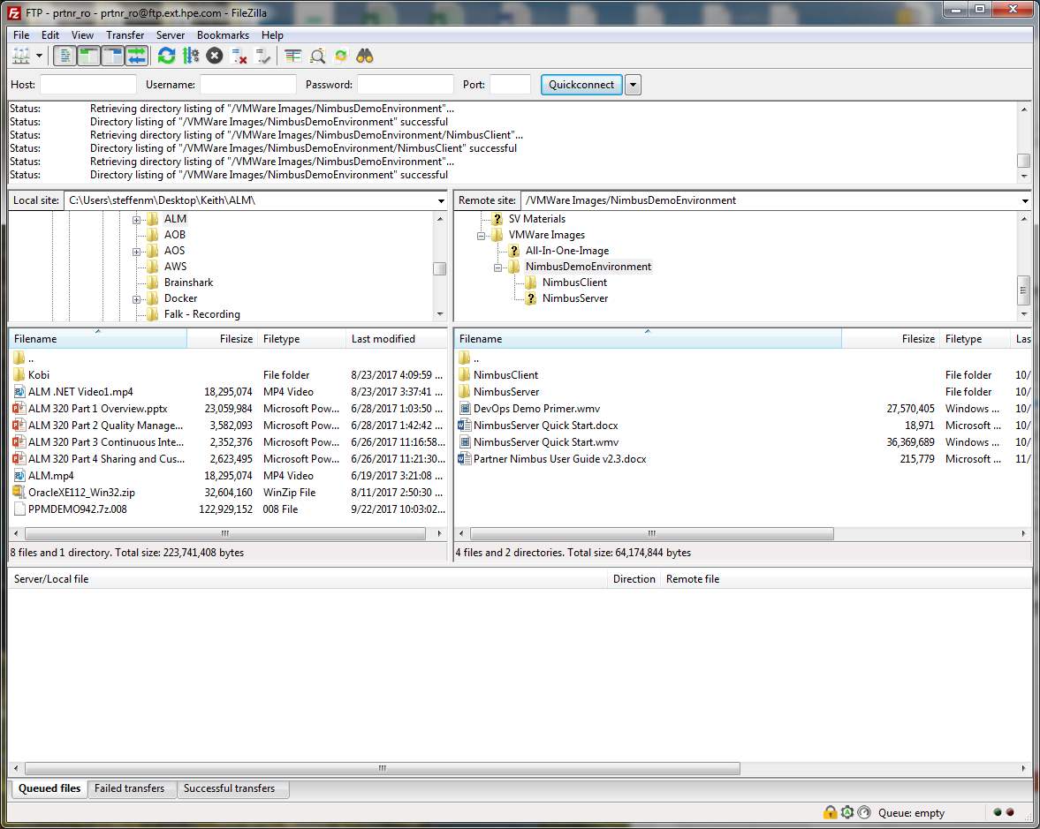
How do Partners get the Nimbus VM Images?
FileZilla is suggested to download
Use 7Zip to extract the archives
Select <filename>.7z001 to extract entire archive
FTP Download Details (for partners)
FTP Site: ftp-pro.houston.softwaregrp.com
Account: prtnr_ro
Password: dn+JT4rn
Directory: /VMWare Images/NimbusDemoEnvironment
Get both NimbusClient and NimbusServer
Must set encryption = Plain FTP (unsecure)
Enable VTx (Virtual Technology) in your BIOS
Select I MOVED IT when first booting any image (or some licensing may fail)
Downloading or Updating the nimbusapp script:
$ wget -nv https://github.com/admpresales/nimbusapp/releases/latest/download/nimbusapp.tar.gz
$ sudo tar -xzf nimbusapp.tar.gz -C /usr/local/bin

Slide 29
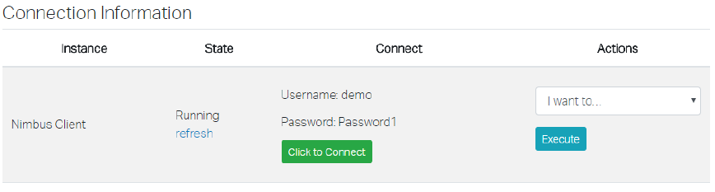
Partners can schedule Blueshift
Register with Blueshift.
Login at https://www.mfdemoportal.com/
Select a category or search (e.g. search for Nimbus)
Request a reservation.
Wait for image to be available (~15 minutes)
Connect to image(s).

Slide 30
Course Roadmap
ADM Demo Environments
Nimbus Demo Environment
What is Nimbus/Blueshift?
Nimbus and Docker
Nimbus VM’s
Docker and Linux Commands
Nimbus Best Practices
Hands-on Exercises
Notes:
This presentation provides an overview of the Nimbus Demo Environment.
[PRESS] What is Nimbus?
[PRESS] How are Nimbus and Docker related?
[PRESS] What are some common Docker commands?
[PRESS] What are some basic Linux commands?
[PRESS] How do I use Nimbus on AWS?
[PRESS] What are some Nimbus best practices?
[PRESS} Followed by some hands-on exercises.

Slide 31
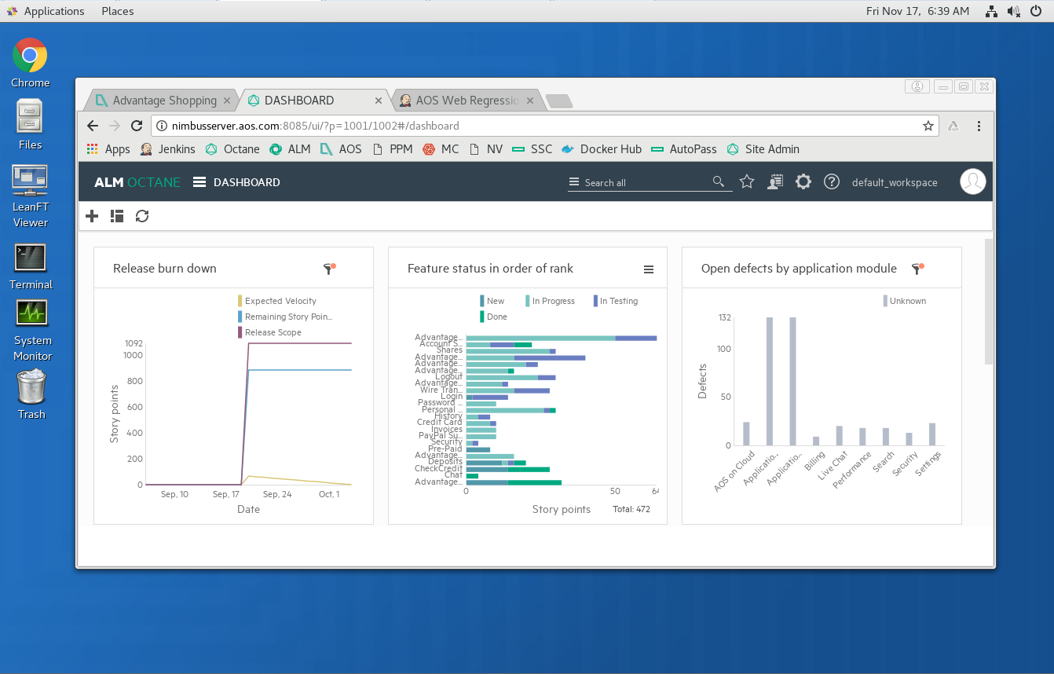
The NimbusServer VM 2020-R1p (CentOS)
Image Highlights
Docker – The NimbusServer image is small and is basically a home for Docker.
Terminal – Use it to run command line statements on the Linux OS.
Browsers – Chrome with shortcuts to Docker-based applications.
System Monitor – Use to monitor when docker containers are fully running and stable.

Slide 32
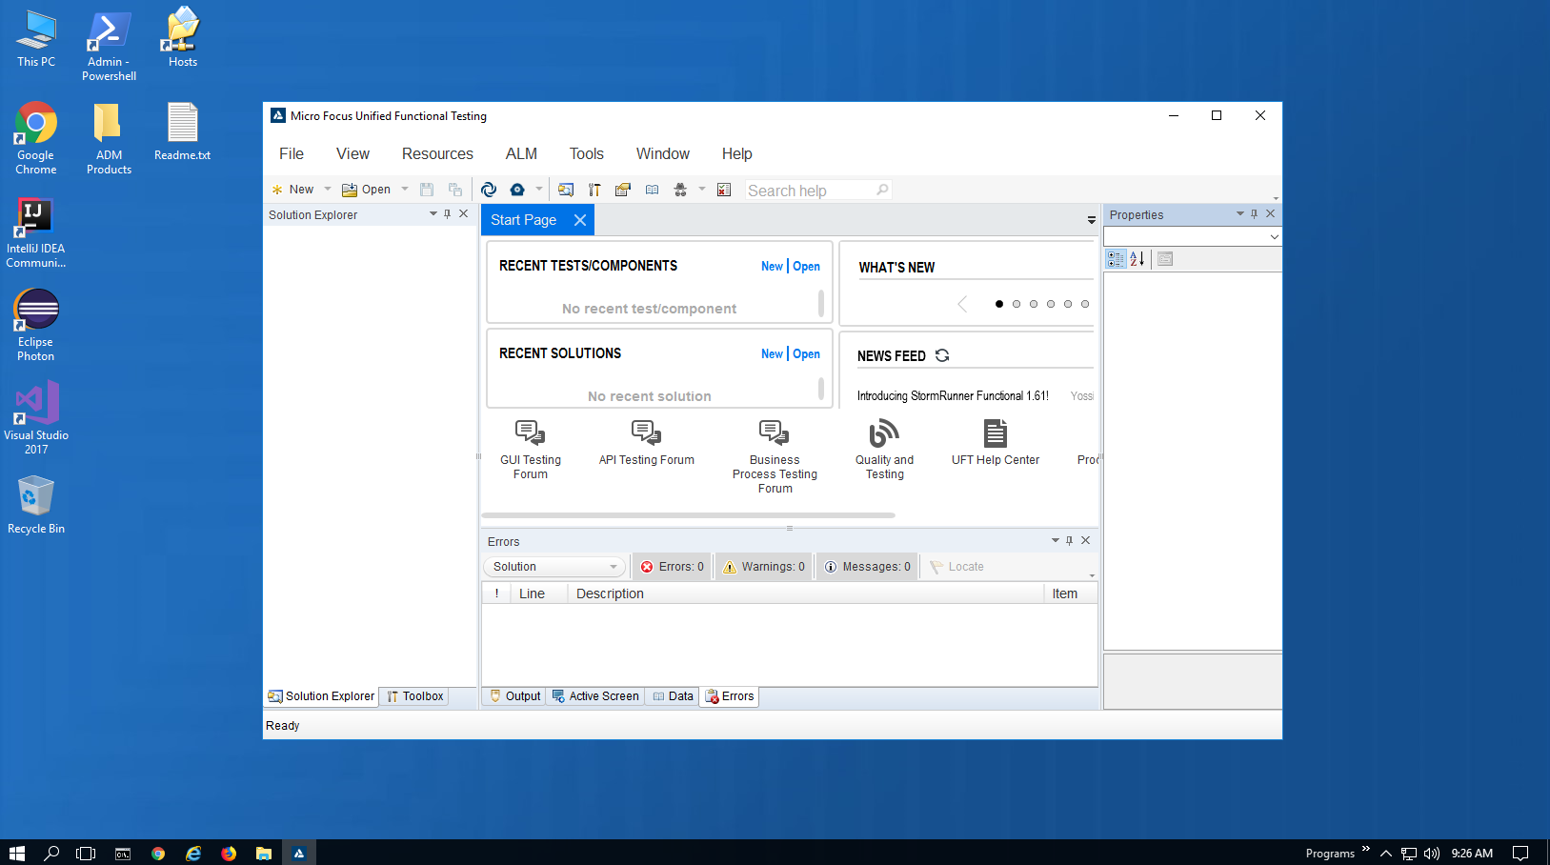
The NimbusClient VM 2020.R1p (Windows Server 2016 Standard)
Image Highlights
UFT – Use UFT to demonstrate functional testing.
SV Designer– Design and emulate API services with Service Virtualization.
Sprinter – Use Sprinter for manual testing activities.
LoadRunner– Perform your load testing demos with LR and TruClient for Chrome.
Mobile Center – Connect to your MC container by configuring the MC Connector to manage your mobile testing.
Licensing – Partners MUST supply a license for Windows Server 2016 Standard.

Slide 33
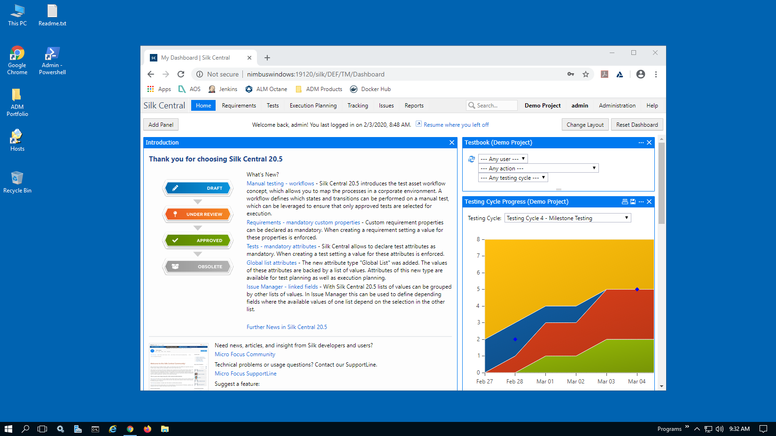
The NimbusWindows VM 2020.R1p (Windows Server 2016 Standard)
Image Highlights
Silk Central – Use Silk Central to organize functional testing.
RPA – Robotic Process Automation.
Dimensions RM – Manage Requirements
SBM – Solutions Business Manager
Release Control – Manage releases
Licensing – Partners MUST supply a license for Windows Server 2016 Standard.

Slide 34
NimbusServer Architecture
NimbusServer VM (CentOS)
AOS
DevOps
ALM .NET
aos_postgres
ALM Octane
postgres
RPA
Jenkins
aos_accountservice
Mobile Center
Maven
GitRepo
Network Virtualization
aos_main
AOS Source
PPM
Tomcat
Fortify SCA
Fortify SSC
Docker

Slide 35
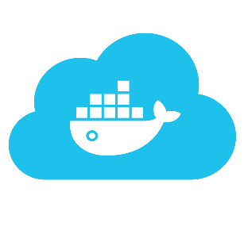
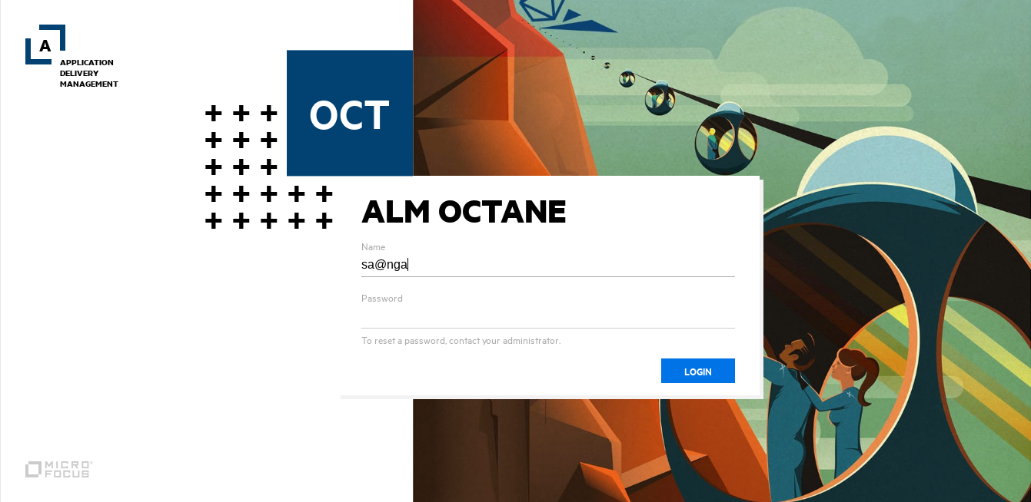
Pulling and Running Images/Containers NimbusServer
Typical Docker commands without nimbusapp
$ docker pull hub.docker.com/admpresales/octane:15.0.20.58_di
$ docker run -d -p 1099:1099 -p 8085:8080 -p 9081:9081 -p 9082:9082 --name octane --hostname octane.aos.com --net demo-net -e OCTANE_HOST=nimbusserver.aos.com --shm-size=2g admpresales/octane:15.0.20.58_di
When must I Log in to Docker Hub?
When pulling images with $ nimbusapp up
$ docker login
$ <enter Your Docker Hub ID>
$ <enter Your Docker Hub Password>
$ nimbusapp octane 15.0.46.68 up
up
up / start
Image
Repository
Container*
Docker Hub
down
removes local image(s)
stop
* Maintains State

Slide 36
Course Roadmap
ADM Demo Environments
Nimbus Demo Environment
What is Nimbus/Blueshift?
Nimbus and Docker
Nimbus VM’s
Docker and Linux Commands
Nimbus Best Practices
Scheduling Blueshift
Hands-on Exercises
Notes:
This presentation provides an overview of the Nimbus Demo Environment.
[PRESS] What is Nimbus?
[PRESS] How are Nimbus and Docker related?
[PRESS] What are some common Docker commands?
[PRESS] What are some basic Linux commands?
[PRESS] How do I use Nimbus on AWS?
[PRESS] What are some Nimbus best practices?
[PRESS} Followed by some hands-on exercises.

Slide 37
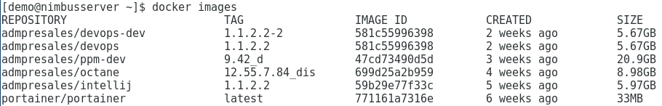
Basic Docker Commands
Display all images $ docker images or $ di
Images can be fully specified by either:
REPOSITORY + : + TAG (e.g. admpresales/devops:1.1.5.1)
IMAGE ID (e.g. 581c55996398)
REPOSITORY alone (if latest) (i.e. portainer/portainer = portainer/portainer:latest)
One image can have multiple names
admpresales/devops-dev:1.1.2.2-2 = admpresales/devops:1.1.2.2
(note possible identical IMAGE ID’s and SIZEs)
Nimbus Image Naming Convention
Images with data have _d extension
Images with integrations have _i extension
images with data and integrations have _di extension

Slide 38
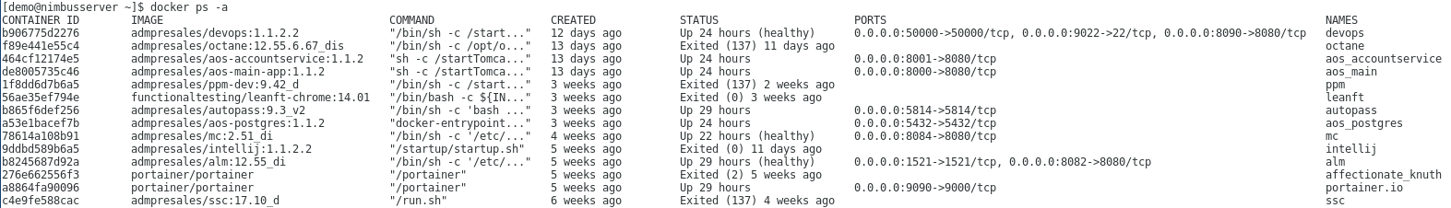
Basic Docker Commands
Display all running containers $ docker ps or $ dps
Display all containers (running or exited) $ docker ps –a or $ dpsa
Enter a container $ docker exec –it octane /bin/bash
or
$ de octane

Slide 39
Basic nimbusapp Commands
Command | Action
docker login | Login to your docker hub repository account (required for “up”)
nimbusapp <name:[version]> start | Start an existing container(s)
nimbusapp <name:[version]> stop | Stop an existing container(s)
nimbusapp <name:[version]> up | Pull image(s) and start the container(s) (requires docker to be logged in)
nimbusapp <name:[version]> down | Stop container(s) and remove them (prompted), leaving image(s)
nimbusapp <name:[version]> restart | Restart / reboot existing container(s)
nimbusapp <name:[version]> ps | Show container(s) status and ports used
Note: the version number is not required if you already pulled the image.

Slide 40
Docker Command Examples
Docker Exec (de)
Enter the file system for autopass $ docker exec –it autopass /bin/bash
[demo@nimbusserver ~]$ pwd
/home/demo
[demo@nimbusserver ~]$ docker exec -it autopass /bin/bash
[root@autopass bin]# pwd
/opt/autopass/apls/apls/bin
Docker Copy
Copy a file into a container $ docker cp ./file.txt autopass:/opt/autopass

Slide 41
Basic Docker Commands
Command | Action | Command | Action
docker login | Login to a repository | docker network | Manage networks
docker run | Pull and run image | docker tag | Create a new tag for an image
docker pull | Pull image only | docker logs | Fetch the logs of a container
docker push | Push image to docker hub | docker inspect | Return info on Docker objects
docker images | List local images | docker rename | Rename a container
docker ps | List containers | docker commit | Commit container to image
docker start | Start running a container | docker restart | Restart (reboot) a container
docker stop | Stop running container | docker top | Display Docker processes
docker rm | Remove a container | docker version | Display Docker version info
docker rmi | Remove an image | docker export | Export container to tar archive
docker exec | Run a command in container | docker import | Import tar archive to container

Slide 42
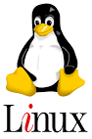
Basic Linux Commands
Command | Action | Command | Action
cd | Change directory | tail | Show last 10 lines of a file
ls | List files | find | Locate a file on the system
pwd | Present working directory | ps | Process status
whoami | Who am I logged is as? | rm | Remove a file (or directory)
su | Switch user | exit | Logout/exit a terminal session
cat | Short for concatenate | echo | Send text to stdout
ping | Package Internet Groper | ifconfig | Display networks
mkdir | Make a directory | chmod | Change file/directory mode
touch | Update a file timestamp | chgrp | Change file/directory group
curl | Transfer data/files | yum | Package installer

Slide 43
Nimbus Demo
Starting a container
Entering a container
Docker and Linux commands

Slide 44
Course Roadmap
ADM Demo Environments
Nimbus Demo Environment
What is Nimbus/Blueshift?
Nimbus and Docker
Nimbus VM’s
Docker and Linux Commands
Nimbus Best Practices
Hands-on Exercises
Notes:
This presentation provides an overview of the Nimbus Demo Environment.
[PRESS] What is Nimbus?
[PRESS] How are Nimbus and Docker related?
[PRESS] What are some common Docker commands?
[PRESS] What are some basic Linux commands?
[PRESS] How do I use Nimbus on AWS?
[PRESS] What are some Nimbus best practices?
[PRESS} Followed by some hands-on exercises.

Slide 45
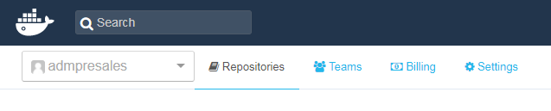
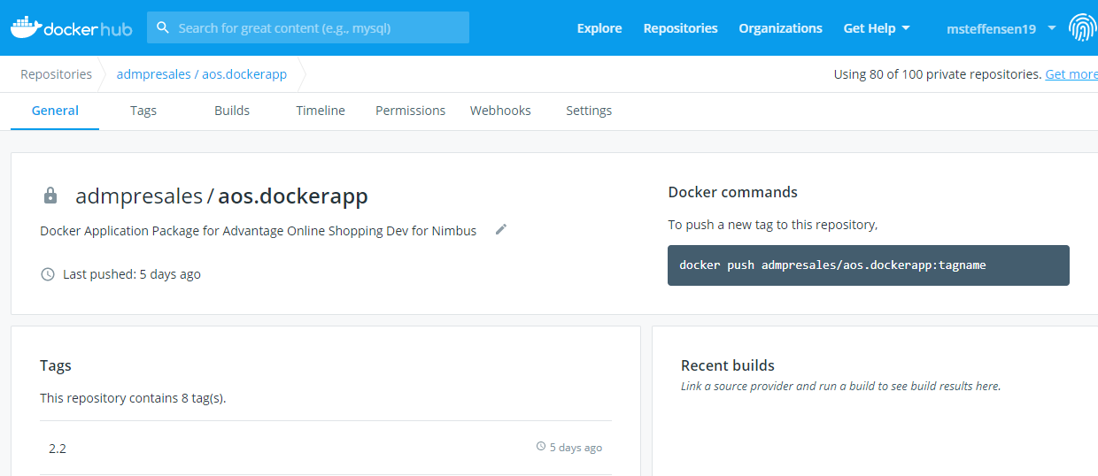
Nimbus Best Practices
When Pulling or Running images ALWAYS examine the Repo Info on Docker Hub
Select the admpresales repository
Select an image name and click the General tab and read the image details

Slide 46
Course Roadmap
ADM Demo Environments
Nimbus Demo Environment
What is Nimbus/Blueshift?
Nimbus and Docker
Nimbus VM’s
Docker and Linux Commands
Nimbus Best Practices
Hands-on Exercises
Notes:
This presentation provides an overview of the Nimbus Demo Environment.
[PRESS] What is Nimbus?
[PRESS] How are Nimbus and Docker related?
[PRESS] What are some common Docker commands?
[PRESS] What are some basic Linux commands?
[PRESS] How do I use Nimbus on AWS?
[PRESS] What are some Nimbus best practices?
[PRESS} Followed by some hands-on exercises.

Slide 47
Important Exercise Instructions
Copying and pasting the dash (-) command may not work because Windows or Adobe often substitutes a different character.
If a command contains a dash and fails, try manually typing the dash character(s) instead of copying/pasting it.

Slide 48
Exercise 1
Command | Action | Command | Action
cd | Change directory | tail | Show last 10 lines of a file
ls | List files | find | Locate a file on the system
pwd | Present working directory | ps | Process status
whoami | Who am I logged is as? | rm | Remove a file (or directory)
su | Switch user | exit | Logout/exit a terminal session
cat | Short for concatenate | echo | Send text to the terminal
ping | Package Internet Groper | ifconfig | Display networks
mkdir | Make a directory | chmod | Change file/directory mode
touch | Update a file timestamp | chgrp | Change file/directory group
curl | Transfer data/files | yum | Package installer
Connecting to Blueshift
Nimbus Basics
Terminal Window Interaction
Basic Linux Commands
Simplified Docker Commands
Logging in to Docker
Docker Image | Tag | Docker Image | Tag
admpresales/alm | 15.0.1 | admpresales/aos-postgres | 2.2
admpresales/octane | 15.0.20.58 | admpresales/aos-accountservice | 2.2
admpresales/devops | 2.2 | admpresales/aos-main-app | 2.2
admpresales/intellij | 2.2 | admpresales/sca | 19.1.2
admpresales/uft-mobile | 3.3 | admpresales/ssc | 19.1.0
admpresales/ppm | 9.55 | admpresales/jira | 8.1.0

Slide 49
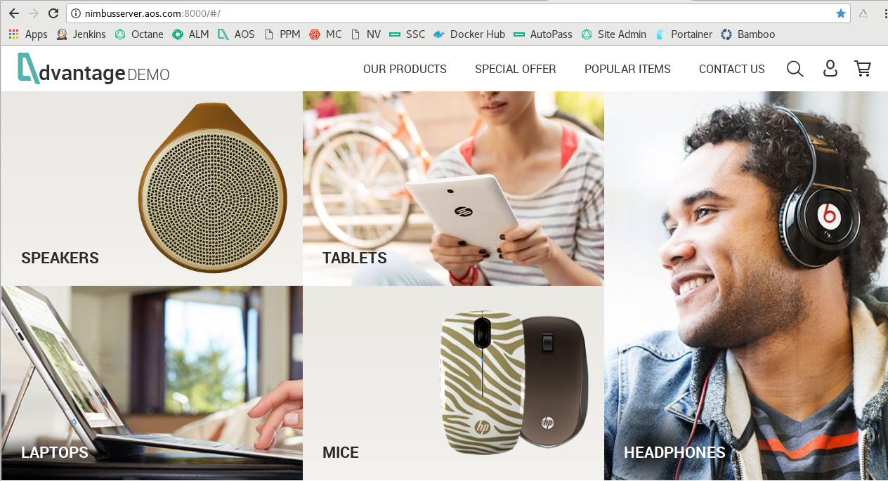
Exercise 2
Starting the AOS Containers
aos-postgres
aos-accountservice
aos-main

Slide 50
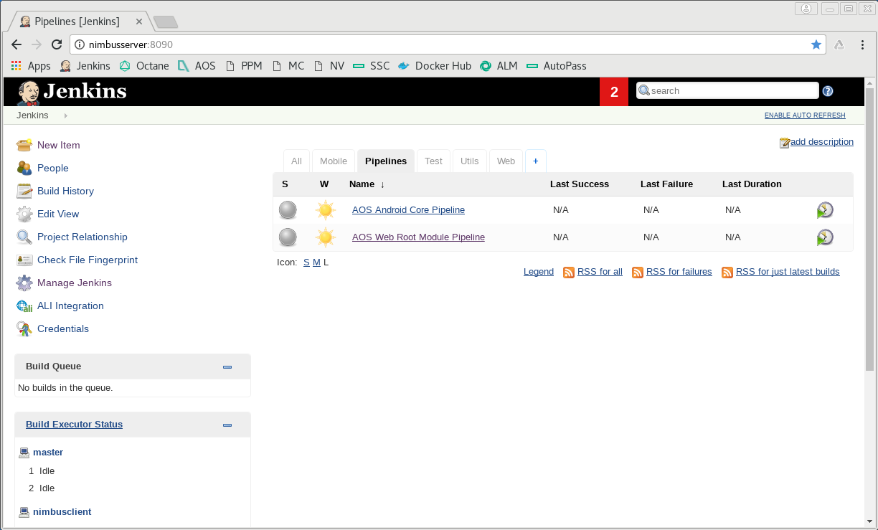
Exercise 3
DevOps is Command Central
Starting the DevOps Container
Jenkins
Bower
Grunt
Maven
NodeJS
AOS Source
GitRepo
You can peek inside a container with $ docker exec –it devops /bin/bash

Slide 51

Hands-on Exercise
Complete Hands-on Exercises #1-3 Nimbus Essentials
You have 60 minutes to complete the exercise
Ask the instructor if you have any questions

Slide 52
Hands-on Exercises #1-3 - Recap
Nimbus and Blueshift Basics
Starting the AOS Containers
Starting the DevOps Container

Slide 53
Kahoot Quiz!
Navigate to https://kahoot.it
Enter the code for this quiz
Have fun!

Slide 54
Nimbus and Blueshift Essentials
Thank You!

